Slide 1
NOSQL

Slide 2
The Big Data Technology Landscape
The big data technology landscape can be majorly studied under two important technologies:
NoSQL
Hadoop

Slide 3
Objective vs. Outcomes
Learning Objectives | Learning Outcomes
The big data technology landscape What is NoSQL databases? Why NoSQL? Key advantages of NoSQL. What is NewSQL? SQL vs. NoSQL. Getting familiar with Hadoop. | Able to understand the significance of NoSQL databases. Able to understand the need for NewSQL. Able to understand the Hadoop platform and be able to appreciate the difference between Hadoop 1.0 and Hadoop 2.0.

Slide 4
Agenda
NoSQL
What is it?
Types of NoSQL Databases
Why NoSQL?
Advantages of NoSQL
NoSQL Vendors
SQL versus NoSQL
NewSQL
Comparison of SQL, NoSQL and NewSQL
Hadoop
Features of Hadoop
Key Advantages of Hadoop
Versions of Hadoop

Slide 5
Typical RDBMS Implementations
Fixed table schemas
Small but frequent reads/writes
Large batch transactions
Focus on ACID – Atomicity – Consistency – Isolation – Durability

Slide 6
ACID
Atomicity – All or Nothing
Consistency – Valid according to all defined rules
Isolation – No transaction should be able to interfere with another transaction
Durability – Once a transaction has been committed, it will remain so, even in the event of power loss, crashes, or errors
Notes:
Atomicity - Step 1: Deduct $100 from Account A. Step 2: Add $100 to Account B. Atomicity ensures that both steps happen together. If a system crash occurs after Step 1 but before Step 2, the entire transaction is rolled back, and no money is deducted from Account A.
Consistency - Before and after the transaction, the total balance in both accounts should remain the same. Initial Total: Account A ($1000) + Account B ($500) = $1500
After Transfer: Account A ($900) + Account B ($600) = $1500
Isolation - Transaction 1: You transfer $100 from Account A to Account B. Transaction 2: At the same time, someone checks the balance of Account A. Isolation ensures that Transaction 2 doesn’t see the intermediate state where $100 has been deducted from Account A but not yet added to Account B. It will only see the balance before or after the transfer, never in between.
Durability -
After transferring $100 from Account A to Account B, the system crashes.
Durability ensures that when the system is back online, the transfer is still reflected in the account balances. The transaction is safely stored in the database.

Slide 7
NoSQL (NOT ONLY SQL)
NoSQL stands for Not Only SQL. These are non-relational, open source, distributed databases.
The term NoSQL was first coined by Carlo Strozzi in 1998 to name his lightweight database that did not expose the standard SQL interface.
NoSQL databases are widely used in big data and other real-time web applications.
Likewise it is used to store social media data and all such data which cannot be stored and analyzed comfortably in RDBMS.

Slide 8
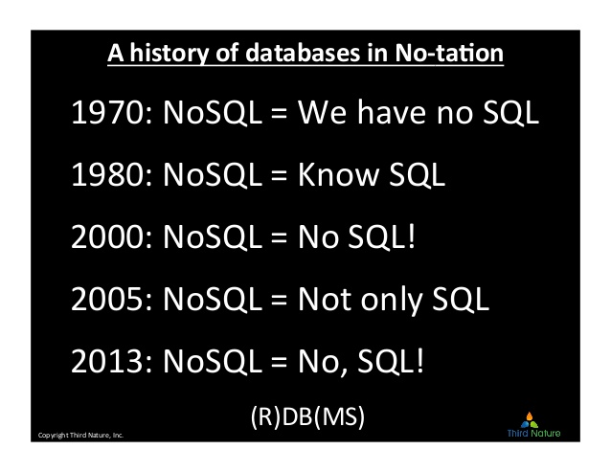

Slide 9
Features of NoSQL
NoSQL databases are non-relational:
They do not adhere to relational data model.
they are either
key-value pairs or
document-oriented, column-oriented or
graph-based databases.
Distributed: data is distributed across several nodes in a cluster constituted of low-cost commodity hardware.
Notes:
Key-value pairs : These databases store data as key-value pairs.
Document databases : These databases store data as semi-structured documents, such as JSON or XML.
Column oriented data stores : These databases store data as column families, which are sets of columns that are treated as a single entity.
Graph-based databases : These databases store data as nodes and edges, and are designed to handle complex relationships between data.

Slide 10
Features of NoSQL
No support for ACID properties (Atomicity, Consistency, Isolation, and Durability):
do not offer support for ACID properties of transactions.
On the contrary, they have adherence to Brewer’s CAP (Consistency, Availability, and Partition tolerance) theorem
and are often seen compromising on consistency in favor of availability and partition tolerance.

Slide 11
Features of NoSQL
No fixed table schema:
NoSQL databases are becoming increasing popular owing to their support for flexibility to the schema.
They do not mandate for the data to strictly adhere to any schema structure at the time of storage.

Slide 12
What is NoSQL?

Slide 13
Types of NoSQL
Key value data store
Riak
Column-oriented data store
Cassandra
Document data store
MongoDB
CouchDB
Redis
Membase
HBase
HyperTable
RavenDB
Graph data store
Infinite Graph
Neo4
Allegro Graph

Slide 14
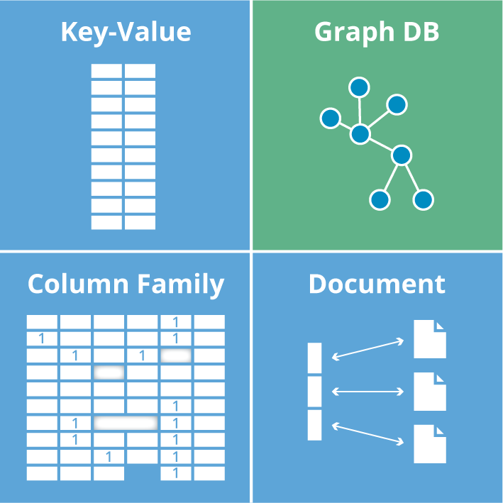
Types of NoSQL

Slide 15
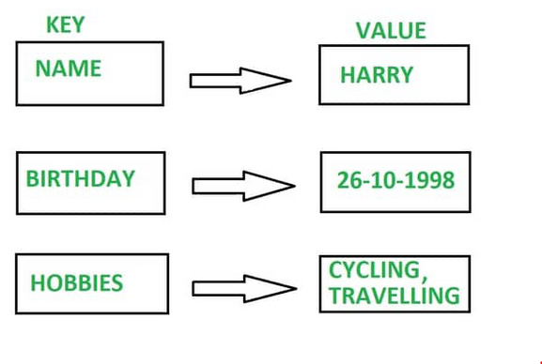
Key-Value Store

Slide 16
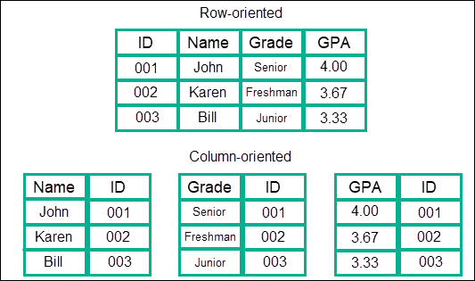
Column Oriented Data Store

Slide 17
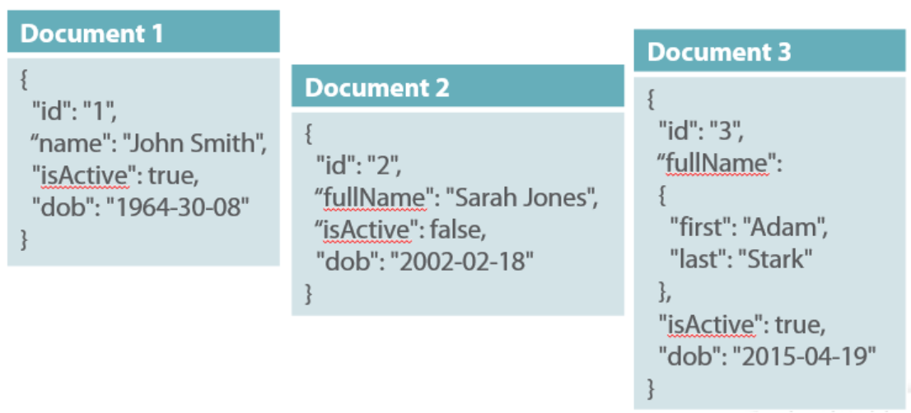
Document Data Store

Slide 18
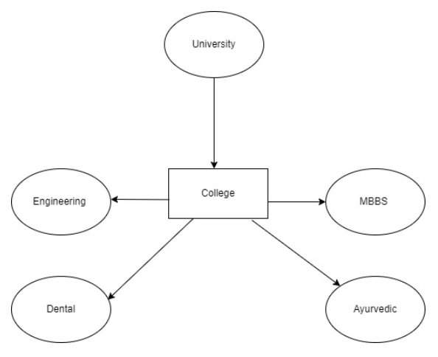
Graph Data Store

Slide 19
Key Value Databases
These DMS store items as alpha-numeric identifiers that refer to the keys. Each key has associated values.
The values could be simple text strings or more complex lists and sets.
Search only performed against keys and limited to exact matches.
Search cannot be performed against values.

Slide 20
Types of NoSQL
Key-value: It maintains a big hash table of keys and values. For example, Dynamo, Redis, Riak, etc.
Sample Key- Value Pair in Key- Value Database
Key Value
First Name Simmonds
Last Name David

Slide 21
What is key-value pair?
A key-value pair (KVP) is a set of two linked data items:
a key, which is a unique identifier for some item of data, and
the value, which is either the data that is identified or a pointer to the location of that data.
Key-value pairs are frequently used in lookup tables, hash tables and configuration files.

Slide 22
Key Value Databases Characteristics
The simplicity of Key-Value Store makes them very quick and light.
Highly scalable retrieval of the values needed for application tasks such as retrieving product names.
This is why Amazon use K-V system, Dynamo, in its shopping cart. Dynamo is a highly available key-value storage system.
Example: Dynamo (Amazon), Voldemort (LinkedIn) Redis, BerkeleyDB, Riak
Notes:
Each user’s shopping cart is key-value pair. The user ID is the key, and the cart contents are the value. This makes it easy to quickly retrieve and update cart information regardless of where the user logs in from.

Slide 23
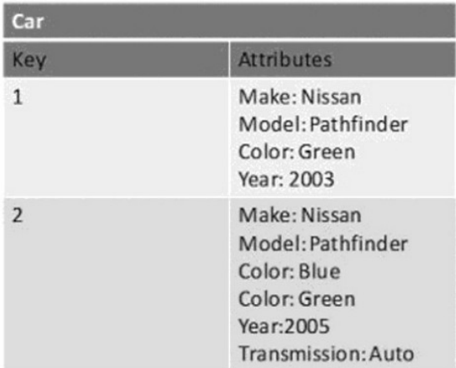
Key Value Databases

Slide 24
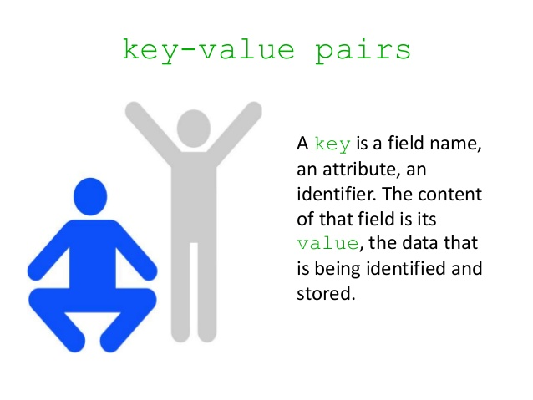

Slide 25
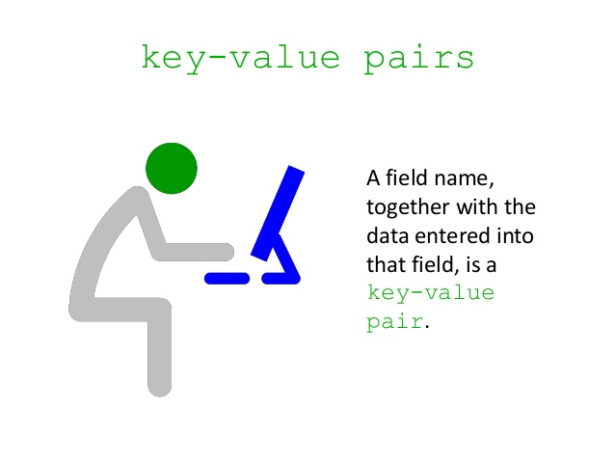

Slide 26
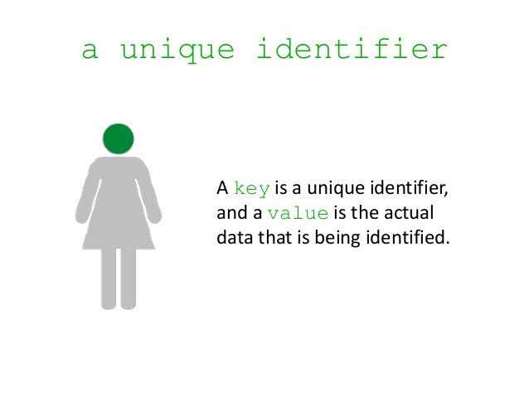

Slide 27
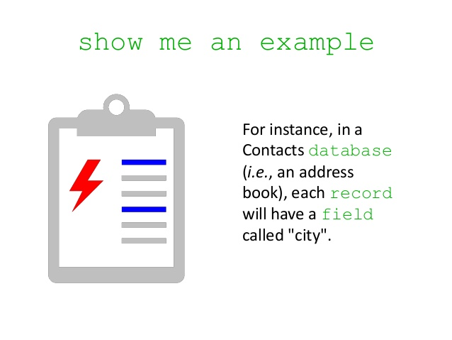

Slide 28
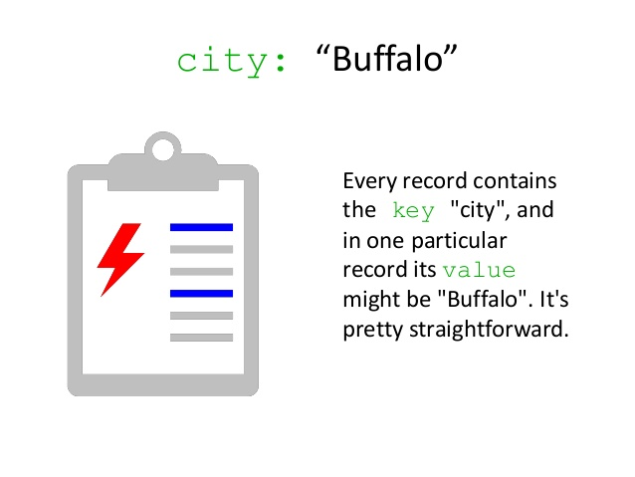

Slide 29
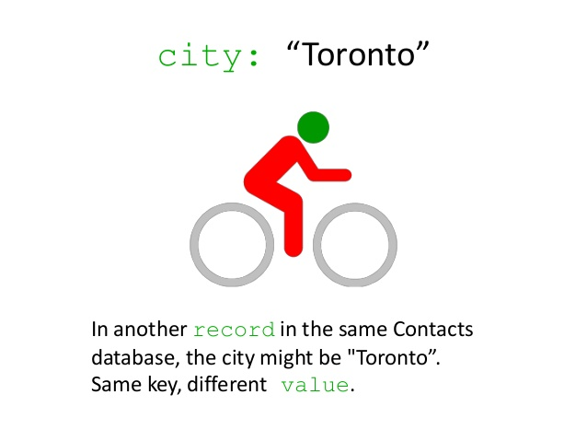

Slide 30
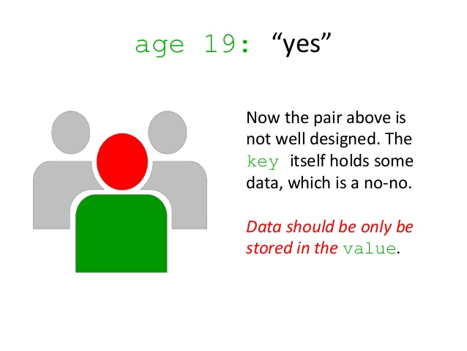

Slide 31
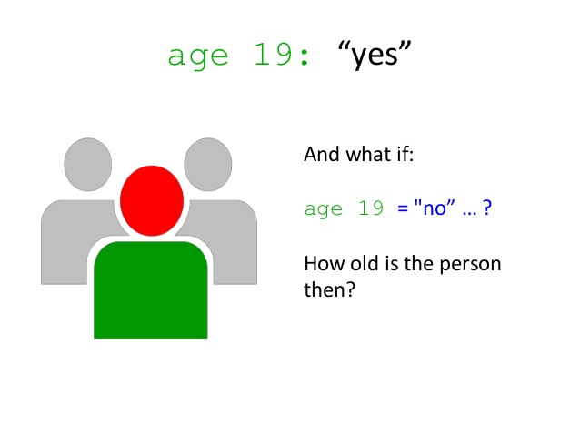

Slide 32
Types of NoSQL
Schema-less
Document: It maintains data in collections constituted of documents. For example, MongoDB, Apache CouchDB, Couchbase, MarkLogic, etc.
Sample Document in Document Database
{
“Book Name”:“Fundamentals of Business Analytics”,
“Publisher”:“Wiley India”,
“Year of Publication”:“2011”
}

Slide 33
Document Databases
Designed to manage and store documents.
These documents are encoded in a standard data exchange format such as XML, JSON (Javascript Option Notation) or BSON (Binary JSON).
Document databases are good for storing and managing Big Data-size collections of literal documents such as text documents, email messages.

Slide 34
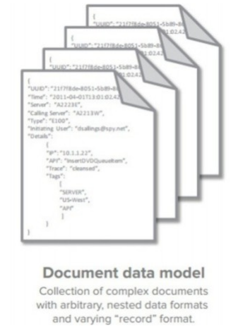
Document Databases

Slide 35
Types of NoSQL
Column: Each storage block has data from only one column. For example: Cassandra, HBase, etc.

Slide 36
Column Family Databases
It consists of a Key-Value pair where the value consists of set of columns.
The column family databases are represented in tables, each key-value pair being a row.
All the related data can be grouped as one family

Slide 37
Column Store NoSQL Database
Data Model
ColumnFamily: ColumnFamily is a single structure that can group Columns and SuperColumns with ease.
Key: the permanent name of the record. Keys have different numbers of columns, so the database can scale in an irregular way.
Keyspace: This defines the outermost level of an organization, typically the name of the application. For example, ‘3PillarDataBase’ (database name).
Column: It has an ordered list of elements aka tuple with a name and a value defined.
The best known examples are Google’s BigTable and HBase & Cassandra that were inspired from BigTable.

Slide 38
Column Store NoSQL Database
BigTable, for instance is a high performance, compressed and proprietary data storage system owned by Google. It has the following attributes:
Sparse – some cells can be empty
Distributed – data is partitioned across many hosts
Persistent – stored to disk
Multidimensional – more than 1 dimension
Map – key and value
Sorted – maps are generally not sorted but this one is
The best known examples are Google’s BigTable and HBase & Cassandra that were inspired from BigTable.

Slide 39
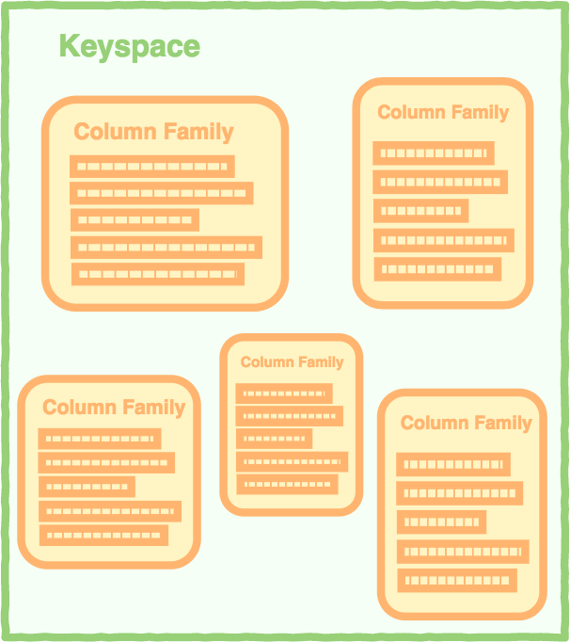
Column Store NoSQL Database

Slide 40
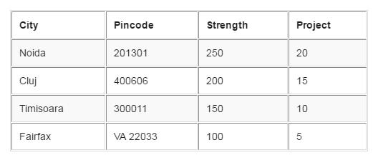
Column Store NoSQL Database
A 2-dimensional table comprising of rows and columns is part of the relational database system.

Slide 41
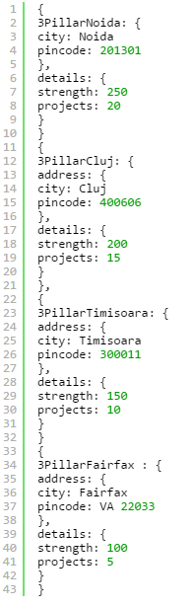
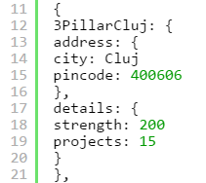
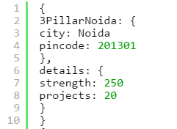
Column Store NoSQL Database
For above RDBMS table a BigTable map can be visualized as shown below.

Slide 42
Column Store NoSQL Database
The outermost keys 3PillarNoida, 3PillarCluj, 3PillarTimisoara and 3PillarFairfax are analogues to rows.
‘address’ and ‘details’ are called column families.
The column-family ‘address’ has columns ‘city’ and ‘pincode’.
The column-family details’ has columns ‘strength’ and ‘projects’.
Columns can be referenced using ColumnFamily.

Slide 43
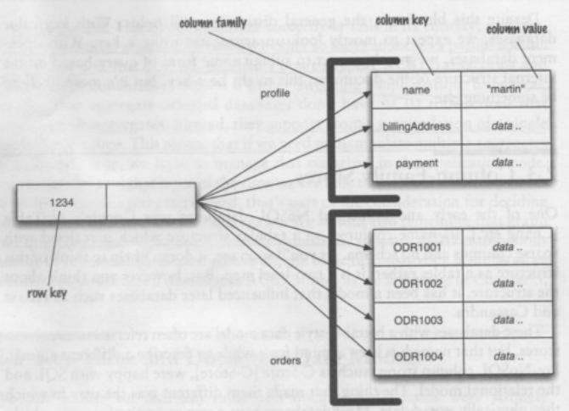
Column Family Databases

Slide 44
Benefits of Column Store Databases
Compression. Column stores are very efficient at data compression and/or partitioning.
Aggregation queries. Due to their structure, columnar databases perform particularly well with aggregation queries (such as SUM, COUNT, AVG, etc).
Scalability. Columnar databases are very scalable. They are well suited to massively parallel processing (MPP)
Fast to load and query. Columnar stores can be loaded extremely fast. A billion row table could be loaded within a few seconds.

Slide 45
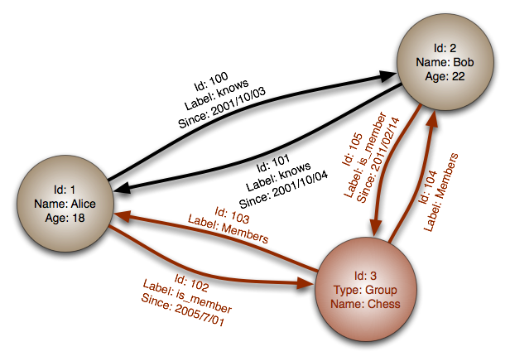
Types of NoSQL
Graph: They are also called network database. A graph stores data in nodes. For example: Neo4j, HyperGraphDB, etc.

Slide 46
Graph Databases
Graph databases replace relational tables with structured relational graphs of interconnected key-value pairings.
Graph databases are useful when you are more interested in relationships between data than the data itself and it works perfectly for the social network.
It is optimized for relationship traversing not for querying
Examples: Neo4j, InfoGrid, Sones GraphDB, AllegroGraph, InfiniteGraph

Slide 47
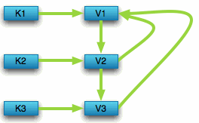

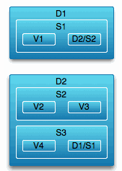
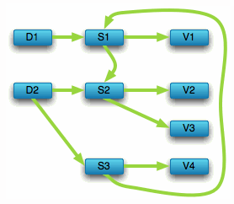

Slide 48
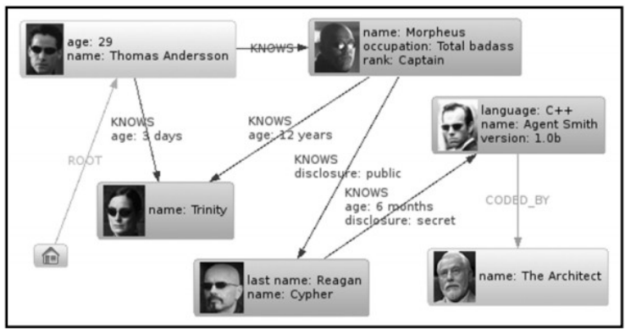
Graph Databases

Slide 49
Why NoSQL
It has scale out architecture instead of the monolithic architecture of relational databases. It can house large volumes of structured, semi-structured, and unstructured data.
Dynamic schema: NoSQL database allows insertion of data without a pre-defined schema. It facilitates application changes in real time, which thus supports faster development, easy code integration, and requires less database administration.

Slide 50
Why NoSQL
Auto-sharding: It automatically spreads data across an arbitrary number of servers. It balances the load of data and query on the available servers; and if and when a server goes down, it is quickly replaced without any major activity disruptions.
Replication: It offers good support for replication which in turn guarantees high availability, fault tolerance, and disaster recovery.

Slide 51
Characteristics of NoSQL
Strong Consistency: all clients see the same version of data.
High Availability: Data always available, at least one copy of the requested data even if one of the nodes is down.
Partition-tolerance: the total system keeps its characteristic even when being deployed on different servers

Slide 52
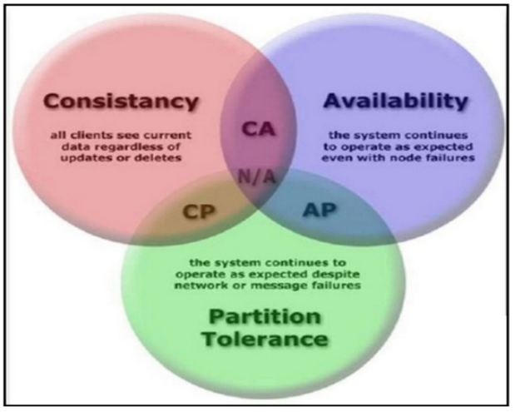
Characteristics of NoSQL

Slide 53
Advantages of NoSQL

Slide 54
Advantages of NoSQL
Can easily scale up and down: NoSQL database supports scaling rapidly and elastically and even allows to scale to the cloud.
Cluster scale: It allows distribution of database across 100+ nodes often in multiple data centers.
Performance scale: It sustains over 100,000+ database reads and writes per second.
Data scale: It supports housing of 1 billion+ documents in the database.

Slide 55
Advantages of NoSQL
Doesn’t require a pre-defined schema: NoSQL does not require any adherence to pre-defined schema.
It is pretty flexible.
For example, if we look at MongoDB, the documents (equivalent of records in RDBMS) in a collection (equivalent of table in RDBMS) can have different sets of key-value pairs.

Slide 56
Advantages of NoSQL
Cheap, easy to implement: Deploying NoSQL properly allows for all of the benefits of scale, high availability, fault tolerance, etc. while also lowering operational costs.

Slide 57
Advantages of NoSQL
Relaxes the data consistency requirement: NoSQL databases have adherence to CAP theorem (Consistency, Availability, and Partition Tolerance). Most of the NoSQL databases compromise on consistency in favor of availability and partition tolerance. However, they do go for eventual consistency.
Data can be replicated to multiple nodes and can be partitioned: There are two terms that we will discuss here:

Slide 58
Advantages of NoSQL
Sharding: Sharding is when different pieces of data are distributed across multiple servers.
NoSQL databases support auto-sharding meaning they can natively and automatically spread data across an arbitrary number of servers, without requiring the application to even be aware of the composition of the server pool. Servers can be added or removed from the data layer without application downtime.
This would mean that data and query load are automatically balanced across servers.

Slide 59
Advantages of NoSQL
Replication: Replication is when multiple copies of data are stored across the cluster and even across data centers. This promises high availability and fault tolerance.

Slide 60
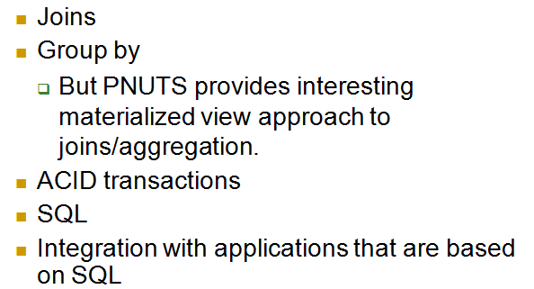
What does NoSQL Not Provide

Slide 61
NoSQL Vendors
Company | Product | Most widely used by
Amazon | DynamoDB | LinkedIn, Mozilla
Facebook | Cassandra | Netflix, Twitter, eBay
Google | BigTable | Adobe Photoshop

Slide 62
SQL Vs. NoSQL
SQL | NoSQL
Relational database | Non-relational, distributed database
Relational model | Model-less approach
Pre-defined schema | Dynamic schema for unstructured data
Table based databases | Document-based or graph-based or wide column store or key-value pairs databases
Vertically scalable (by increasing system resources) | Horizontally scalable (by creating a cluster of commodity machines)

Slide 63
SQL Vs. NoSQL
SQL | NoSQL
Uses SQL | Uses UnQL (Unstructured Query Language)
Not preferred for large datasets | Largely preferred for large datasets
Not a best fit for hierarchical data | Best fit for hierarchical storage as it follows the key-value pair of storing data similar to JSON (Java Script Object Notation)
Emphasis on ACID properties | Follows Brewer’s CAP theorem
Excellent support from vendors | Relies heavily on community support

Slide 64
SQL Vs. NoSQL
SQL | NoSQL
Supports complex querying and data keeping needs | Does not have good support for complex querying
Can be configured for strong consistency | Few support strong consistency (e.g., MongoDB), few others can be configured for eventual consistency (e.g., Cassandra)
Examples: Oracle, DB2, MySQL, MS SQL, PostgreSQL, etc. | MongoDB, HBase, Cassandra, Redis, Neo4j, CouchDB, Couchbase, Riak, etc.

Slide 65
NewSQL
We need a database that has the same scalable performance of NoSQL systems for On Line Transaction Processing (OLTP) while still maintaining the ACID guarantees of a traditional database.
This new modern RDBMS is called NewSQL. It supports relational data model and uses SQL as their primary interface.
NewSQL is based on the shared nothing architecture with a SQL interface for application interaction.

Slide 66
NewSQL

Slide 67
SQL Vs. NoSQL Vs. NewSQL
 | SQL | NoSQL | NewSQL
Adherence to ACID properties | Yes | No | Yes
OLTP/OLAP | Yes | No | Yes
Schema rigidity Adherence to data model | Yes Adherence to relational model | No | Maybe
Data Format Flexibility | No | Yes | Maybe
Scalability | Scale up Vertical Scaling | Scale out Horizontal Scaling | Scale out
Distributed Computing | Yes | Yes | Yes
Community Support | Huge | Growing | Slowly growing

